Slide 1
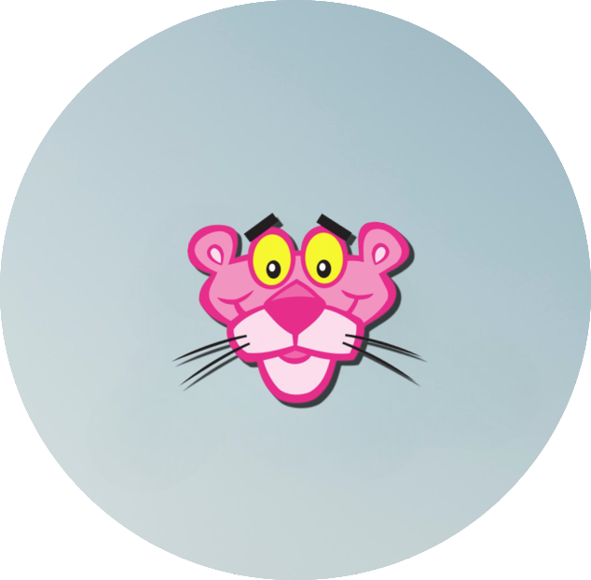
Fast Food Pink Panther Crikvenica
Official Style Guide

Slide 2
TABLE OF CONTENTS
01
02
03
Our strategy
04
Typography
Here you could describe the topic of the section
Here you could describe the topic of the section
Our logo
05
Application feel
Here you could describe the topic of the section
Here you could describe the topic of the section
Color standards
Here you could describe the topic of the section

Slide 3
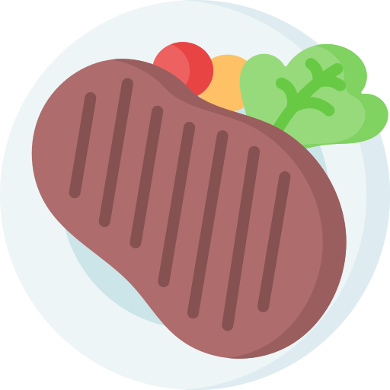

INTRODUCTION
Mercury is the closest planet to the Sun and the smallest one in our Solar System—it’s only a bit larger than the Moon

Slide 4
01
OUR STRATEGY
You can enter a subtitle here if you need it

Slide 5
PERSONALITY
Mars
Jupiter
Saturn
Despite being red, Mars is a cold place full of iron oxide dust
Jupiter is a gas giant and the biggest planet in the Solar System
Saturn is composed mostly of hydrogen and helium

Slide 6
01
OUR LOGO
You can enter a subtitle here if you need it

Slide 7
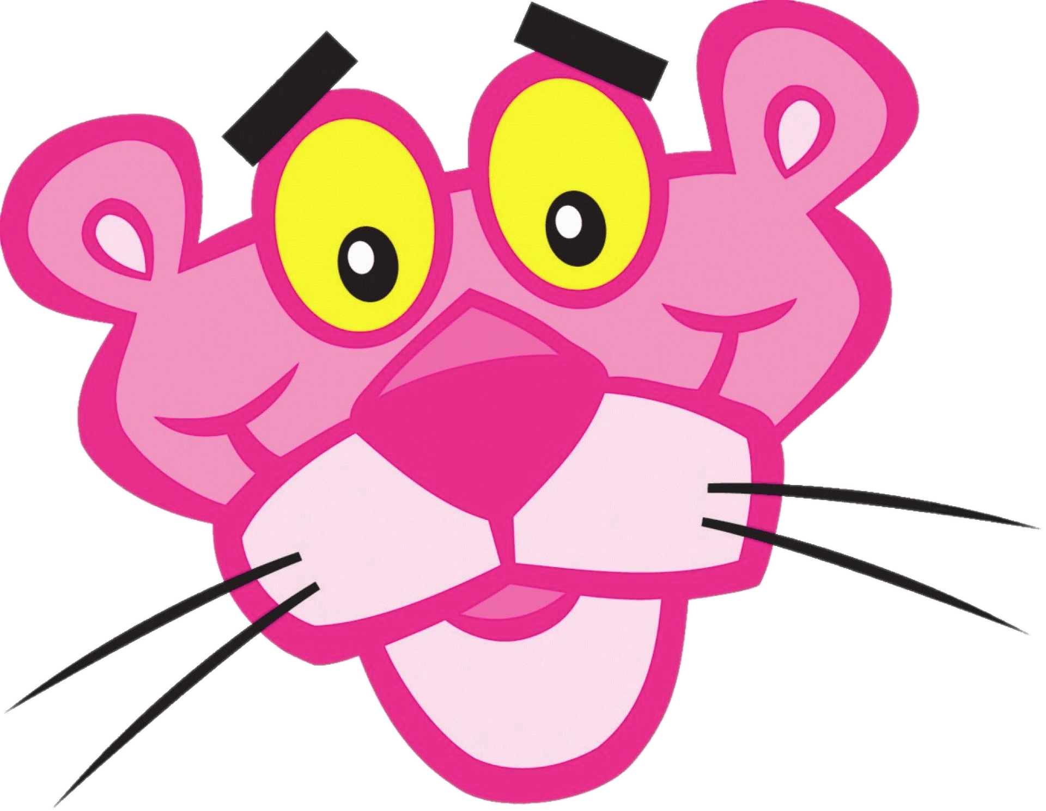
LOGO

Slide 8
LOGO CONCEPT
Mercury is the closest planet to the Sun and the smallest one in our Solar System—it’s only a bit larger than the Moon. The planet’s name has nothing to do with the liquid metal, since Mercury was named after the Roman messenger god

Slide 9
BRAND CONSTRUCTION
5px
5px
Venus has a beautiful name and is the second planet from the Sun. It’s terribly hot—even hotter than Mercury—and its atmosphere is extremely poisonous

Slide 10
CLEAR SPACE REQUIREMENTS
Despite being red, Mars is actually a cold place. It’s full of iron oxide dust, giving the planet its reddish cast

Slide 11
DIMENSIONS
25mm
15mm
150px
100px
60px
Print
Digital
Jupiter is a gas giant and the biggest planet of them all in the Solar System
Saturn is a gas giant and has rings. It’s composed mostly of hydrogen and helium

Slide 12
DOS
Here you can describe the correct uses of your logo
Here you can describe the correct uses of your logo
Here you can describe the correct uses of your logo

Slide 13
DON’TS
Here you can describe the incorrect uses of your logo
Here you can describe the incorrect uses of your logo
Here you can describe the incorrect uses of your logo

Slide 14
02
COLOR STANDARDS
You can enter a subtitle here if you need it

Slide 15
COLOR STANDARDS
#FFC0CB
#FF69B4
#FF1493
#000000
RGB: 255 192 203
RGB: 255 105 180
RGB: 255 20 147
RGB: 00 00 00

Slide 16
COLOR GUIDELINES
3 Colors
Positive (1 color)
Negative (1 color)
Despite being red, Mars is a cold place full of iron oxide dust
Mercury is the smallest planet in the Solar System
Jupiter is the biggest planet in the Solar System

Slide 17
03
TYPOGRAPHY
You can enter a subtitle here if you need it

Slide 18
TYPOGRAPHY
Aa
Aa
Anton
Aa Bb Cc Dd Ee Ff Gg Hh Ii Jj Kk Ll Mm Nn Oo Pp Qq Rr Ss Tt Uu Vv Ww Yy Zz
Raleway
Aa Bb Cc Dd Ee Ff Gg Hh Ii Jj Kk Ll Mm Nn Oo Pp Qq Rr Ss Tt Uu Vv Ww Yy Zz

Slide 19
03
APPLICATION FEEL
You can enter a subtitle here if you need it

Slide 20

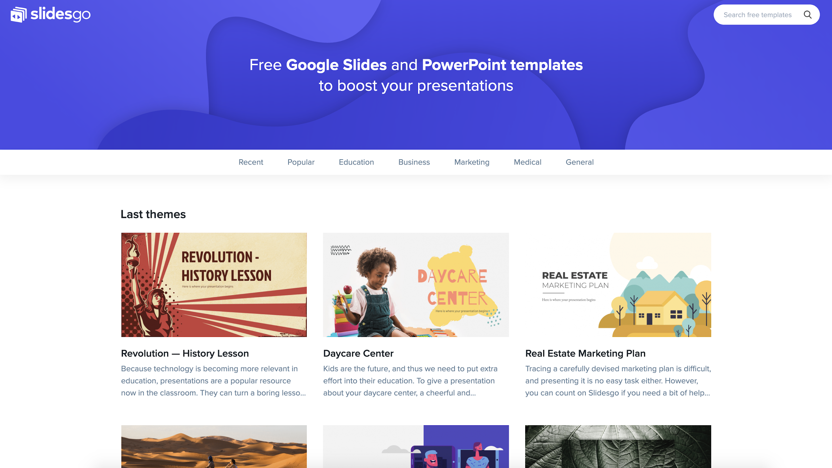
Mockup
You can replace the image on the screen with your own work. Just delete this one, add yours and center it properly

Slide 21
ICONOGRAPHY

Slide 22
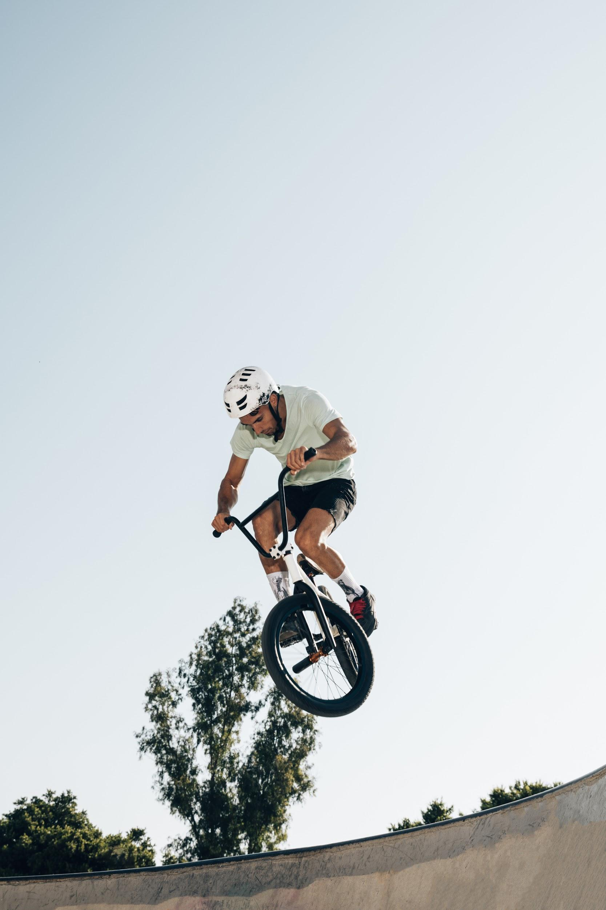
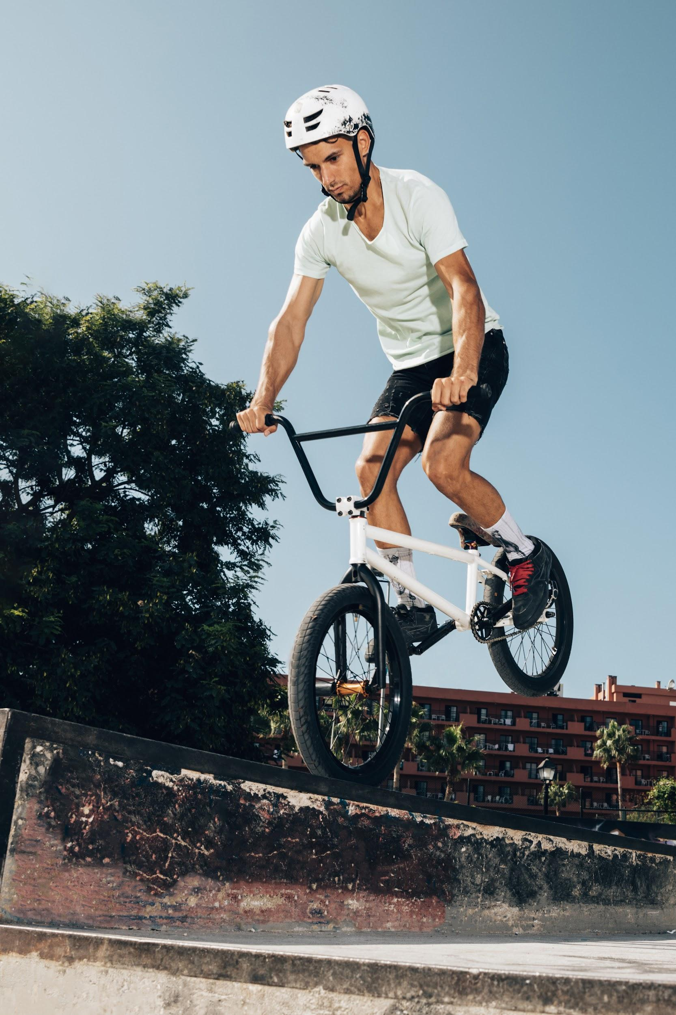
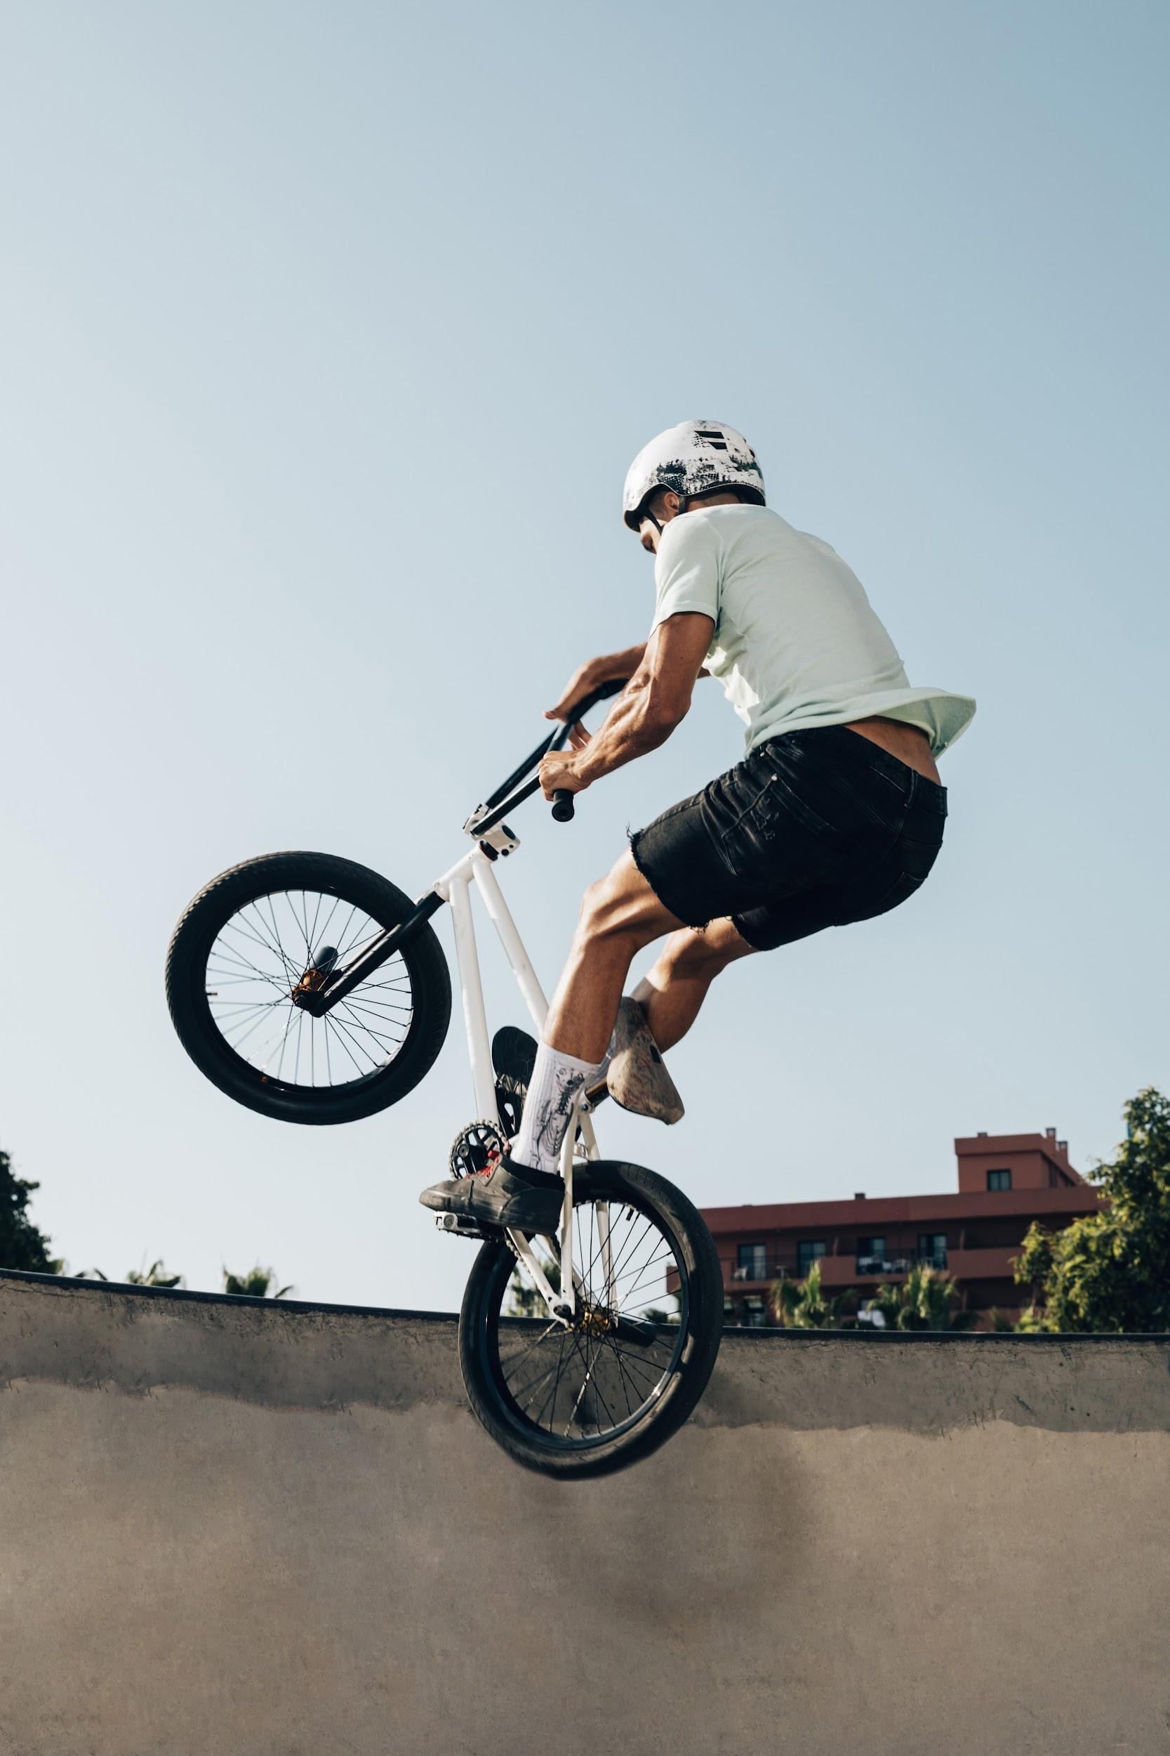

IMAGE GUIDELINES
Venus has a beautiful name and is the second planet from the Sun. It’s terribly hot, even hotter than Mercury

Slide 23
IMAGE CONCEPT
Mercury is the closest planet to the Sun and the smallest one in the Solar System—it’s only a bit larger than the Moon

Slide 24
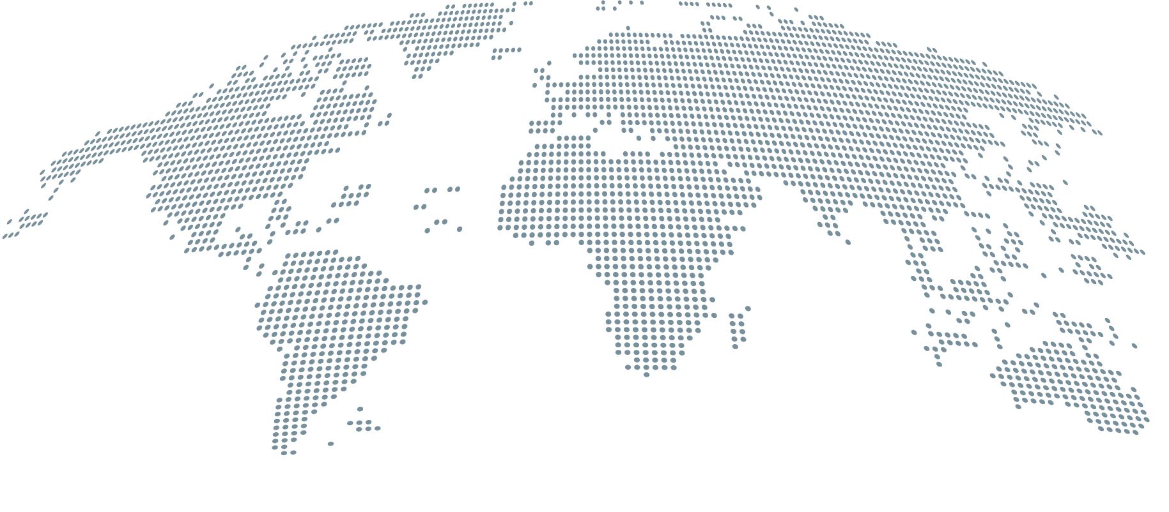
HEADQUARTERS
Jupiter
Jupiter is the biggest planet in the Solar System
Mars
Despite being red, Mars is actually a cold place

Slide 25
OUR HISTORY
1
2
3
4
Venus is the second planet from the Sun
Saturn is a gas giant and has several rings
Despite being red, Mars is a cold place
Mercury is the closest planet to the Sun

Slide 26

“This is a quote, words full of wisdom that someone important said and can make the reader get inspired.”
—Someone Famous

Slide 27
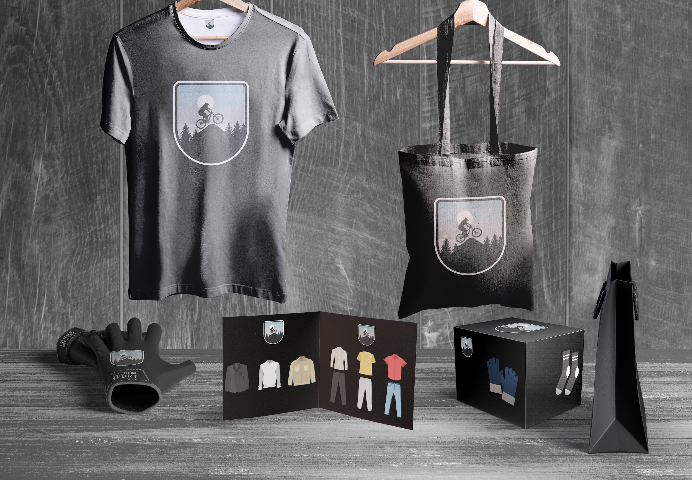
APPLICATIONS
Venus is a planet with a beautiful name and is the second one from the Sun. It’s terribly hot and its atmosphere is poisonous

Slide 28
THANKS!
Do you have any questions? youremail@freepik.com +91 620 421 838 yourcompany.com
Please keep this slide for attribution.

